Slide 1


Slide 2
7 Genres
Books of Moses
(5)
Genesis
Exodus
Leviticus
Numbers
Deuteronomy
History
(12)
Joshua
Judges
Ruth
1-2 Samuel
1-2 Kings
1-2 Chronicles
Ezra
Nehemiah
Esther
Wisdom
(5)
Job
Psalms
Proverbs
Ecclesiastes
Song of Solomon
Prophets
(17)
Isaiah
Jeremiah
Lamentations
Ezekiel
Daniel
Hosea
Joel
Amos
Obadiah
Jonah
Micah
Nahum
Habakkuk
Zephaniah
Haggai
Zechariah
Malachi
Gospels
(5)
Matthew
Mark
Luke
John
Acts
Epistles
(21)
Romans
1-2 Corinthians
Galatians
Ephesians
Philippians
Colossians
1-2 Thessalonians
1-2 Timothy
Titus
Philemon
Hebrews
James
1-2 Peter
1-3 John
Jude
Final Prophecy
(1)
The Revelation

Slide 3
Chronological
Genesis
Job
Exodus
Leviticus
Numbers
Deuteronomy
Joshua
Judges
Ruth
1st Samuel
2nd Samuel
Psalms
1st Chronicles
Song of Solomon
Proverbs
Ecclesiastes
1st Kings
2nd Chronicles
Obadiah
2nd Kings
Jonah
Isaiah
Amos
Micah
Hosea
Nahum
Zephaniah
Jeremiah
Habakkuk
Lamentations
Ezekiel
Joel
Daniel
Ezra
Haggai
Zechariah
Esther
Nehemiah
Malachi
Matthew
Mark
Luke
John
Acts
James
Galatians
1st Thessalonians
2nd Thessalonians
1st Corinthians
2nd Corinthians
Romans
Colossians
Philemon
Ephesians
Philippians
1st Timothy
Titus
1st Peter
Hebrews
2nd Timothy
2nd Peter
Jude
1st John
2nd John
3rd John
Revelation

Slide 4
Genesis (1445-1405 B.C.)
Recounts the history from the creation
of the Universe through the 12 tribes
of Israel in Egypt.

Slide 5
Job (???)
This is the story of trials, tribulations
and the patience of a righteous
man named Job

Slide 6
Exodus (1445-1405 B.C.)
God saves Israel from slavery in Egypt
by Moses. He gives them the law and
the tabernacle.

Slide 7
Leviticus (1445-1405 B.C.)
God gives Israel instructions for how
to worship Him.

Slide 8
Numbers (1445-1405 B.C.)
Israel fails to trust and obey God, and
wanders in the wilderness for 40 years.

Slide 9
Deuteronomy (1445-1405 B.C.)
The second giving of the law and
the death of Moses

Slide 10
Joshua (1405-1385 B.C.)
Joshua leads Israel to conquer the
Promised land and divides the land
to the twelve tribes.

Slide 11
Judges (1043 B.C.)
Cycles of Israel falling, being oppressed,
repenting, and being rescued by judges.

Slide 12
Ruth (1030-1010 B.C.)
Two widows lose everything, but then
find hope in Israel and God.

Slide 13
1st Samuel (931-722 B.C.)
The prophet Samuel is followed by Israel
demanding a king. Saul reigns as the
1st king.

Slide 14
2nd Samuel (931-722 B.C.)
David, a man after God’s own heart,
becomes king of Israel.

Slide 15
Psalms (1410-450 B.C.)
A songbook of 150 songs mostly written
by David for Israel to use in worship.

Slide 16
1st Chronicles (450-430 B.C.)
Chronology of Israel from Adam to David,
ending with David commissioning the
temple.

Slide 17
Song of Solomon (971-965 B.C.)
A love song celebrating love, desire, and
marriage. Possibly an allegory about the
church.

Slide 18
Proverbs (971-686 B.C.)
A collection of wise sayings
written by Solomon.

Slide 19
Ecclesiastes (940-931 B.C.)
Solomon concludes that man should
fear God and keep his commandments
instead of the vain things of this world.

Slide 20
1st Kings (561-538 B.C.)
The kingdom of Israel at peace under
Solomon, but then divides into Israel
and Judah.

Slide 21
2nd Chronicles (450-430 B.C.)
Solomon builds the temple, but the
Babylonians take Israel captive and
destroy the temple.

Slide 22
Obadiah (850-840 B.C.)
Obadiah warns the nation of Edom that
they will be judged for plundering their
brother, Israel.

Slide 23
2nd Kings (561-538 B.C.)
Israel falls captive to the Assyrians,
Judah falls captive to the Babylonians.

Slide 24
Jonah (775 B.C.)
A disobedient prophet runs from God,
is swallowed by a great fish, and then
preaches God’s message to the city
of Nineveh, the capital city of the
Assyrian Empire.

Slide 25
Isaiah (700-681 B.C.)
God sends Isaiah to warn Israel of future
judgment—but also to tell them about
a coming Messiah

Slide 26
Amos (750 B.C.)
A shepherd named Amos preaches
against the Northern Kingdom of Israel.

Slide 27
Micah (735-710 B.C.)
Micah predicts Assyrian and Babylonian
captivities and the Messiah’s birth in
Bethlehem.

Slide 28
Hosea (750-710 B.C.)
Hosea marries a prostitute who leaves
him, but he redeems her. An analogy
of God and His people.

Slide 29
Nahum (650 B.C.)
Nahum predicts the destruction of
Nineveh, the capital of Assyria.

Slide 30
Zephaniah (635-625 B.C.)
God warns that he will judge Judah,
but eventually restore them.

Slide 31
Jeremiah (586-570 B.C.)
God sends Jeremiah to warn Israel
about the coming Babylonian captivity.

Slide 32
Habakkuk (615-605 B.C.)
Habakkuk learns that God will raise
up the Babylonians to punish Judah
but then the Babylonians will be
punished once God has used them.

Slide 33
Lamentations (586 B.C.)
Jeremiah’s sorrow about the
destruction of Jerusalem and
the temple.

Slide 34
Ezekiel (590-570 B.C.)
God sends Ezekiel to warn and
comfort the Jews during their captivity.

Slide 35
Joel (835-796 B.C.)
God sends a plague of locusts to
judge Israel, but his judgment on
the surrounding nations is coming, too.

Slide 36
Daniel (536-530 B.C.)
Daniel has elevated rank in the
Babylonian and Persian empires,
and prophesies about the Messiah
and His church.

Slide 37
Ezra (457-444 B.C.)
Zerubbabel and Israel rebuild the
temple, and Ezra teaches the people
to obey God’s laws.

Slide 38
Haggai (520 B.C.)
The people have abandoned the work
of restoring God’s temple in Jerusalem
so Haggai tells them to get back to work.

Slide 39
Zechariah (480-470 B.C.)
The prophet Zechariah calls Israel to
return to God, and foretells the future
Messiah

Slide 40
Esther (450-331 B.C.)
Esther becomes queen of Persia and
saves the Jews from extermination by
Haman.

Slide 41
Nehemiah (424-400 B.C.)
Nehemiah rebuilds the wall around
Jerusalem.

Slide 42
Malachi (433-424 B.C.)
Malachi predicts the coming of
John the Baptist followed by the
Messiah to turn the hearts of God’s
children back to Him

Slide 43
Matthew (50-60 A.D.)
This is an account of Jesus’
birth, life, death, and resurrection,
focusing on Jesus’ role as the true
king of the Jews.

Slide 44
Mark (50-60 A.D.)
Mark gives an account of Jesus’
earthly ministry highlighting Jesus’
authority and servanthood.

Slide 45
Luke (60-61 A.D.)
The only Gentile gospel writer,
Luke writes the most thorough
account of Jesus’ life, pulling
together eyewitness testimonies
to tell the full story of Jesus.

Slide 46
John (80-90 A.D.)
John writes the most unique account
of Christ listing 7 miracles and 7 I AM
statements proving that Jesus was God.

Slide 47
Acts (62 A.D.)
Jesus returns to the Father,
the Holy Spirit comes to the
church, and the gospel of
Jesus spreads throughout the
world through apostles and
evangelists.

Slide 48
James (44-49 A.D.)
A letter written by the Lord’s brother
telling Christians that a true faith will
produce good works.

Slide 49
Galatians (49-50 A.D.)
Paul tells the Galatian churches
that we are justified by faith and
not by works of the law.

Slide 50
1st Thessalonians (51 A.D.)
Paul has heard a good report on
the church at Thessalonica, and
encourages them to continue in faith,
hope, and love.

Slide 51
2nd Thessalonians (51-52 A.D.)
Paul instructs the Thessalonians on how
to stand firm until the coming of Jesus.

Slide 52
1st Corinthians (55 A.D.)
Paul attempts to correct some errors in
a church with divisions in Corinth.

Slide 53
2nd Corinthians (55-56 A.D.)
Paul writes a letter of reconciliation
to the church at Corinth, and defends
his own character.

Slide 54
Romans (56 A.D.)
Paul summarizes how we are justified
by Jesus’s sacrifice in a letter to the
churches at Rome, where he plans to visit.

Slide 55
Colossians (60-62 A.D.)
Paul writes the church at Colossae
a letter about who they are in Christ,
and how to walk in Christ.

Slide 56
Philemon (60-62 A.D.)
Paul strongly recommends that
Philemon accept his runaway slave,
Onesimus as a brother in Christ.

Slide 57
Ephesians (60-62 A.D.)
Paul writes to the church at Ephesus
that the church is not a building but
people who walk in grace, peace,
and love.

Slide 58
Philippians (60-62 A.D.)
An encouraging letter to the church of
Philippi from Paul, telling them how to
have joy in Christ.

Slide 59
1st Timothy (62-64 A.D.)
Paul instructs Timothy in the work of an
evangelist on how to lead a church
with sound teaching and a godly
example.

Slide 60
Titus (62-64 A.D.)
Paul advises Titus on the work of an
evangelist and how to lead churches
on the decadent island of Crete.

Slide 61
1st Peter (64-65 A.D.)
Peter writes to Christians to live holy
lives despite being persecuted.

Slide 62
Hebrews (67-69 A.D.)
A letter to the Jews that there is now a
more perfect sacrifice, temple and
High Priest.

Slide 63
2nd Timothy (66-67 A.D.)
Paul is nearing the end of his life, and
encourages Timothy to continue
preaching the Word.

Slide 64
2nd Peter (67-68 A.D.)
Peter writes a letter warning Christians
that false teachers will come.

Slide 65
Jude (68-70 A.D.)
A letter encouraging Christians to
contend for the faith, and be aware
of false teachers.

Slide 66
1st John (90-95 A.D.)
John writes a letter to Christians
about keeping Jesus’ commands
and loving one another.

Slide 67
2nd John (90-95 A.D.)
A postcard about walking in truth, love,
and obedience.

Slide 68
3rd John (90-95 A.D.)
Another postcard to Gaius about
Christian fellowship and hospitality.

Slide 69
Revelation (94-96 A.D.)
John sees visions of things that have
been, things that are, and things that
are yet to come.

Slide 70
Chronologospel 2021 A.D.
Thanks for reading with us! Join us again in…

Slide 71
2022 A.D.
NT4X Plan
New Testament 4 Times
Once every 90 days!

Slide 72
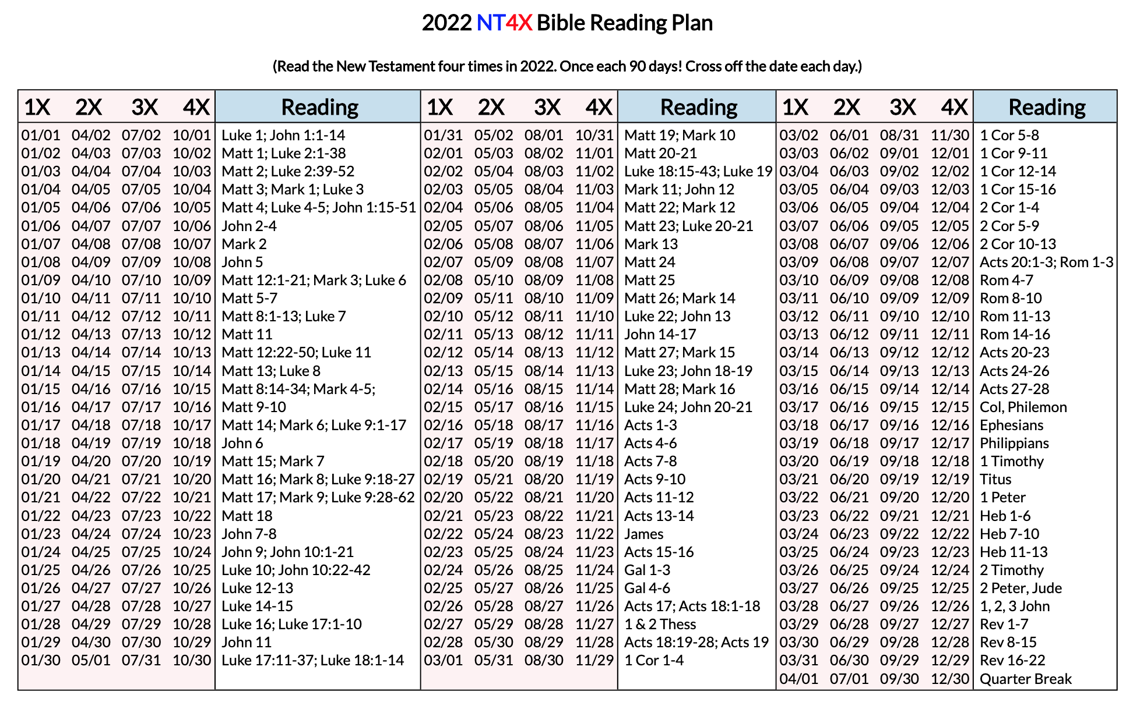

Slide 73
For I am not ashamed of the gospel,
because it is the power of God that
brings salvation to everyone who
believes. For in the gospel the
righteousness of God is revealed.
[Romans 1:16-17]

